Slide 1
Our vilage Uherské Hradiště
Students Parliament Uherské Hradiště

Slide 2
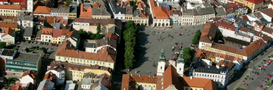
This is our vilage
photo of our city
Our village is called Uherské Hradiště.

Slide 3
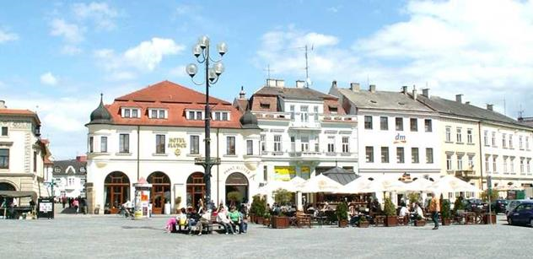
We have a total of 25,246 inhabitants throughout the municipality.
We have 27 representatives in the council.
shops on Masaryk Square

Slide 4
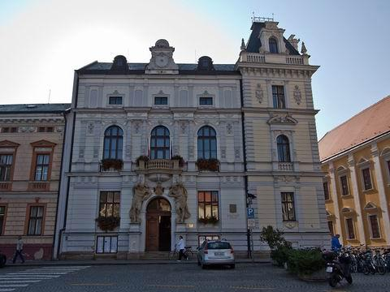
Our mayor is named Ing. Stanislav Blaha.
City hall

Slide 5
Zlín Region
Our vilage is located in the Zlín Region.
The governor is named Jiří Čunek.
emblem of our city

Slide 6
This is our vilage ☺
Thanks for watching

