Slide 1
ERASMUS +
Student Parliament – Empowering the school through the use Students´own ideas, interests, and their active involment

Slide 3
Schools involved in the Project:
Základní škola Za Alejí - Czech Republic (Uherské Hradiště) – Coordinators of the Project https://www.zszaaleji.cz/
Colegio Nuestra Seňora del Rosario – SPAIN (Valencie – Paterna) http://www.dominicaspaterna.es/

Slide 4
Pumpuru vidusskola – Latvia (Jürmala) http://pumpuri.lv/lv/
Bodnant Community School – UK(Prestatyn)
https://www.ysgolbodnant.co.uk/
Gozo College Rabat Primary Malta
https://ourhappyschool.wordpress.com/

Slide 5
Mobilities:
The project lasts 2 years
(September 2019 - August 2021)
October 2019- Czech Republic
March 2020 – UK
June 2020 – Malta
November 2020- Latvia
May 2021 – Spain

Slide 6
Mobilities:
Each trip is attended by 6 pupils and 2 teachers.
Duration of the trip: 6 days
At the trips, children will attend lessons and will have the opportunity to get to know the system of foreign education. Besides, we will visit many interesting places and we will work together on a project concerning the Student Parliament.
Accommodation and meals will be provided in the host families.
All costs are covered by the Erasmus project.
It will be the responsibility of the host family to provide food, accommodation and transport to the school and events we will organize for the children of the project.

Slide 7
Aim of the Project:
Streamlining a functioning Student parliament and its sustainability in the schools involved
Establishment of Student Parliament in Spain
we want to ensure that a single functional parliament is established, drawing on the experience of partner parliaments. Other parliaments will inspire each other, share their experiences and learn from their achievements and mistakes.
Involving members of the Student Parliament and other pupils in this international project

Slide 8
Aim of the Project:
exchange of pupils' and teachers´experience through etwinning, videoconferencing, web, facebook….
working with etwinning and project´s website
improvement in English language

Slide 9
Inspiration from foreign schools not only from the Student's Parliament and
sharing experiences of different countries and cultures

Slide 10
Our tasks:
Creating a project logo
Creation of web and facebook pages of the project
Questionnaires for students of all schools concerning the project and the countries involved

Slide 11
Our tasks:
Working with etwinning on the project
Project Days at Schools - Mapping School Environment, European Parliament Elections, Getting Acquainted with Schools and Work in the Environment, International Project Days
Establishment of a Constitution for further parliamentary activities

Slide 12
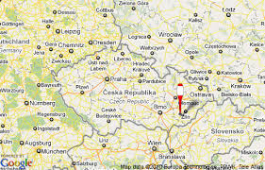
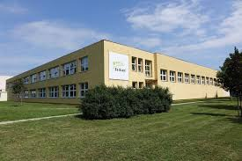
Základní škola Za Alejí – Czech Republic (Uherské Hradiště)
The primary and lower secondary school. The school has been refurbished in recent years and is equipped with modern classrooms. The school curriculum is called Activity, Creativity and Cooperation. In the school year 2013/2014 the first Montessori class was opened. In our school we have 550 students that start at the age of 6 till 15 years. In our school we have 40 teachers and 12 assistants. At school we have a well-functioning Student Parliament, from which other schools are inspired. The Student Parliament is Coordinator for Student´s Parliament in the Czech Republic.

Slide 13
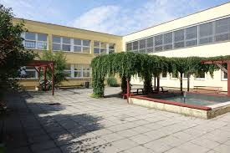
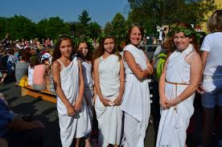
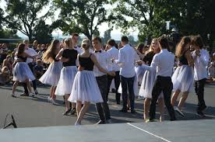
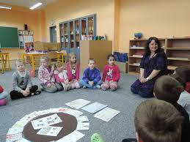
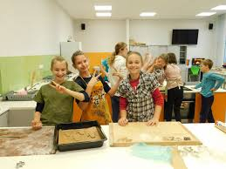

Slide 14
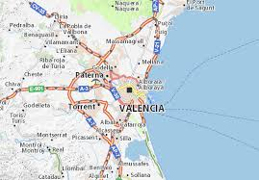
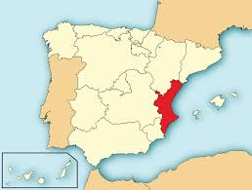
Colegio Nuestra Seňora del Rosario – SPAIN (Paterna – Valencia)
The private school that receives funds from the government. In the school they have 707 students that start at the age of 3 (Kindergarten) till 16 years, the end of Secondary. In the school we have 108 employees.
The staff of our school is very young, what implies a lot of enthusiasm and energy in order to develop all these kind of projects. At the same time, some people of the staff has a lot of experience in exchanges in Europe and America, taking part in the past in a Comenius called: Bridges not walls, with six European countries.
They are interested in this project because they want to learn from other parliaments from different countries and this will help them to establish a functional parliament at their school.

Slide 16
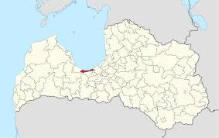
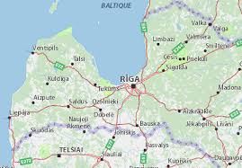
Pumpuru vidusskola – Latvia - Jürmala
Pumpuri Secondary School is located in Jurmala, about 30 km from capital city of Latvia. There are 682 students and 54 teachers in Pumpuri Secondary school. Age of pupils from 5 to 19 years. The school offers 5 educational programs: pre-school, primary education, secondary education, general secondary education with mathematics, natural sciences and technical direction and general secondary education professionally oriented program - police assistant. School social life is organized by Student Parliament, such as "active projects". In the project, they want to inspire working parliaments in Europe and strengthen pupils' involvement in the school.

Slide 17
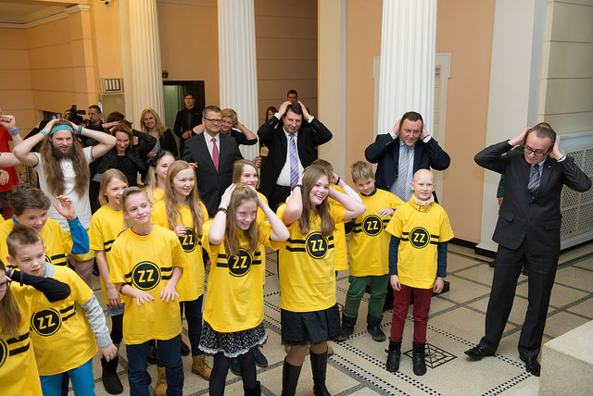
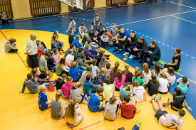
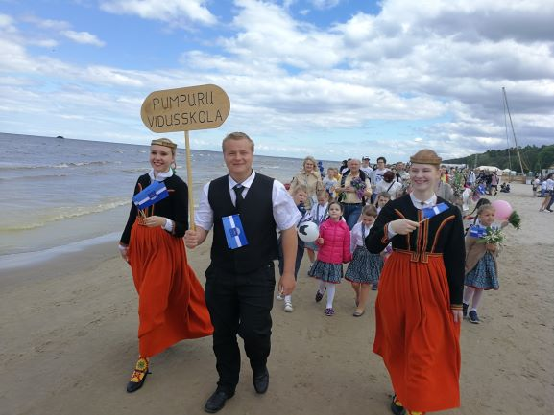

Slide 18
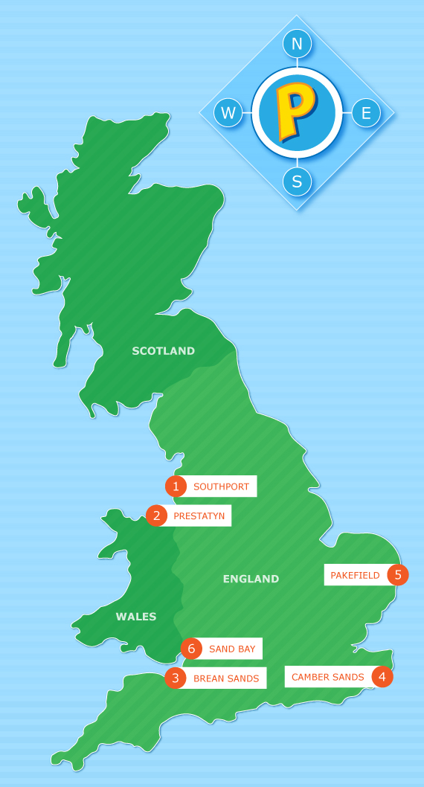
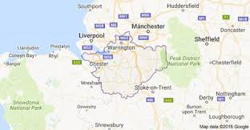
Bodnant Community School – Prestatyn – UK (Wales)
Bodnant Community School is a large primary school with 400+ pupils from 3 years to 11 years. They have 17 teachers and 15 support staff. They believe it is so important for the pupils to see how small the world actually is, how close they are to our European friends, and how easy it can be to share stories, experiences and friendships with each other.Although they teach their pupils about different countries, cultures etc, nothing can beat working with their peers in those other countries, either meeting them face to face or via the internet or letters. The School has Student Parliament, where the pupils are involved in School Life. Each class votes for a representative to be their class councillor. Then these children have weekly meetings, sometimes with headteacher, sometimes the governons on events they would like the school to do, or write to companies for equipment that the school need etc. In the project, they want to inspire working parliaments in Europe and strengthen pupils' involvement in the school.

Slide 19
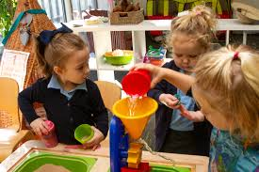
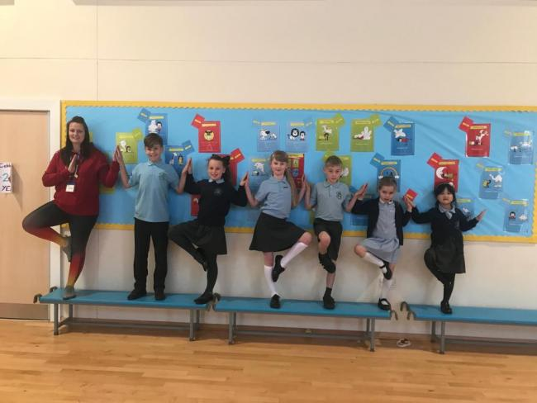
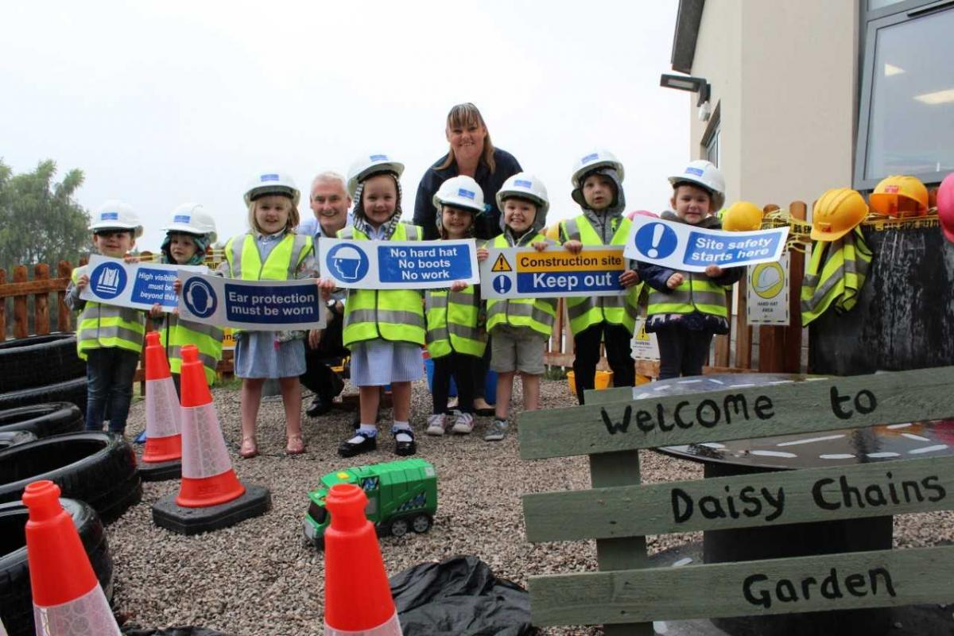

Slide 20
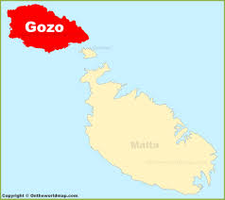
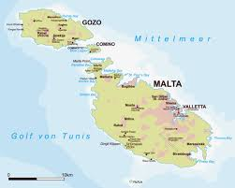
Gozo College Rabat Primary – Malta - Gozo
Gozo College Rabat Primary, known as the Happy School, is one of the 11 primary state schools that are found on the island of Gozo. Situated in the heart of the capital town of the island Victoria, it hosts over 390 pupils between the ages of 3 to 11. In addition to 25 classrooms, the school has administrative offices, a well-equipped library, 2 playgrounds and a workshop. The Gozo College Rabat Primary School is the biggest primary school in Gozo. Every day, 380 children spend 6 hours at our school. The school’s motto is We are a Happy School. The school provides opportunities and organizes activities which help children develop their personal and social skills and thus increasing their self esteem. Children are encouraged to actively engage in school life. Once a week they do the morning assembly, they play an active role in the Student Parliament. They organise activities themselves. The school has been involved in eTwinning. The experience gained will surely help in this project. In the project, we want also to inspire the working parliaments in Europe and strengthen their pupils' involvement in the school.

Slide 21
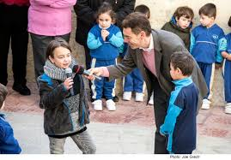
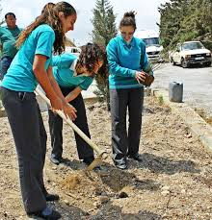
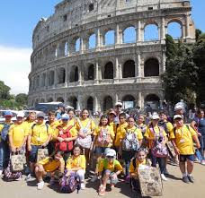
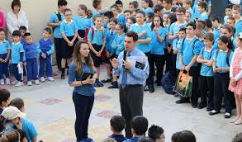

Slide 22
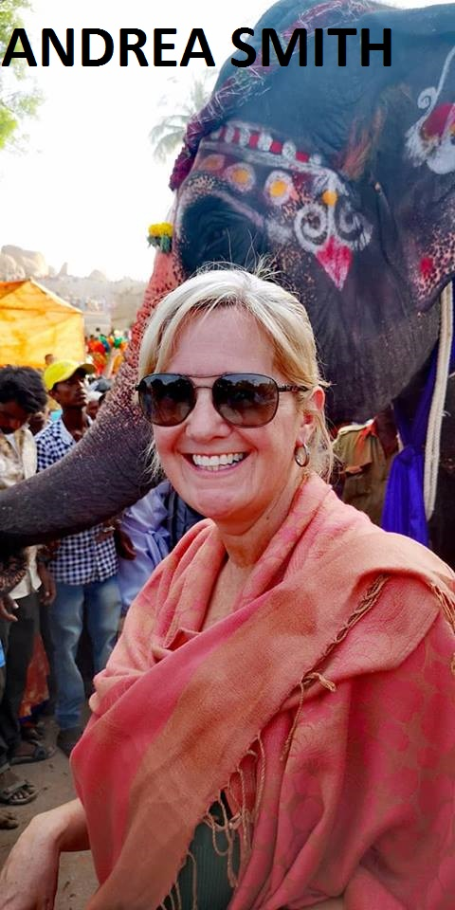
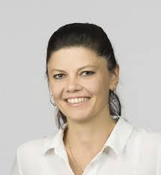
Coordinators:

Slide 23
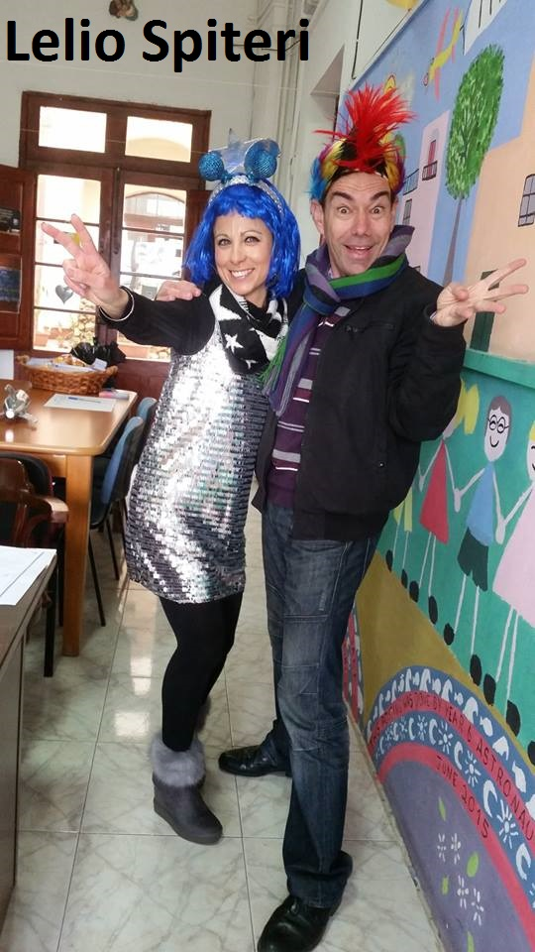
Koordinátoři projektů

Slide 24
We are looking forward to this project☺

